Slide 1
OE3C Catering Order Estimate
March 22 2026

Slide 2
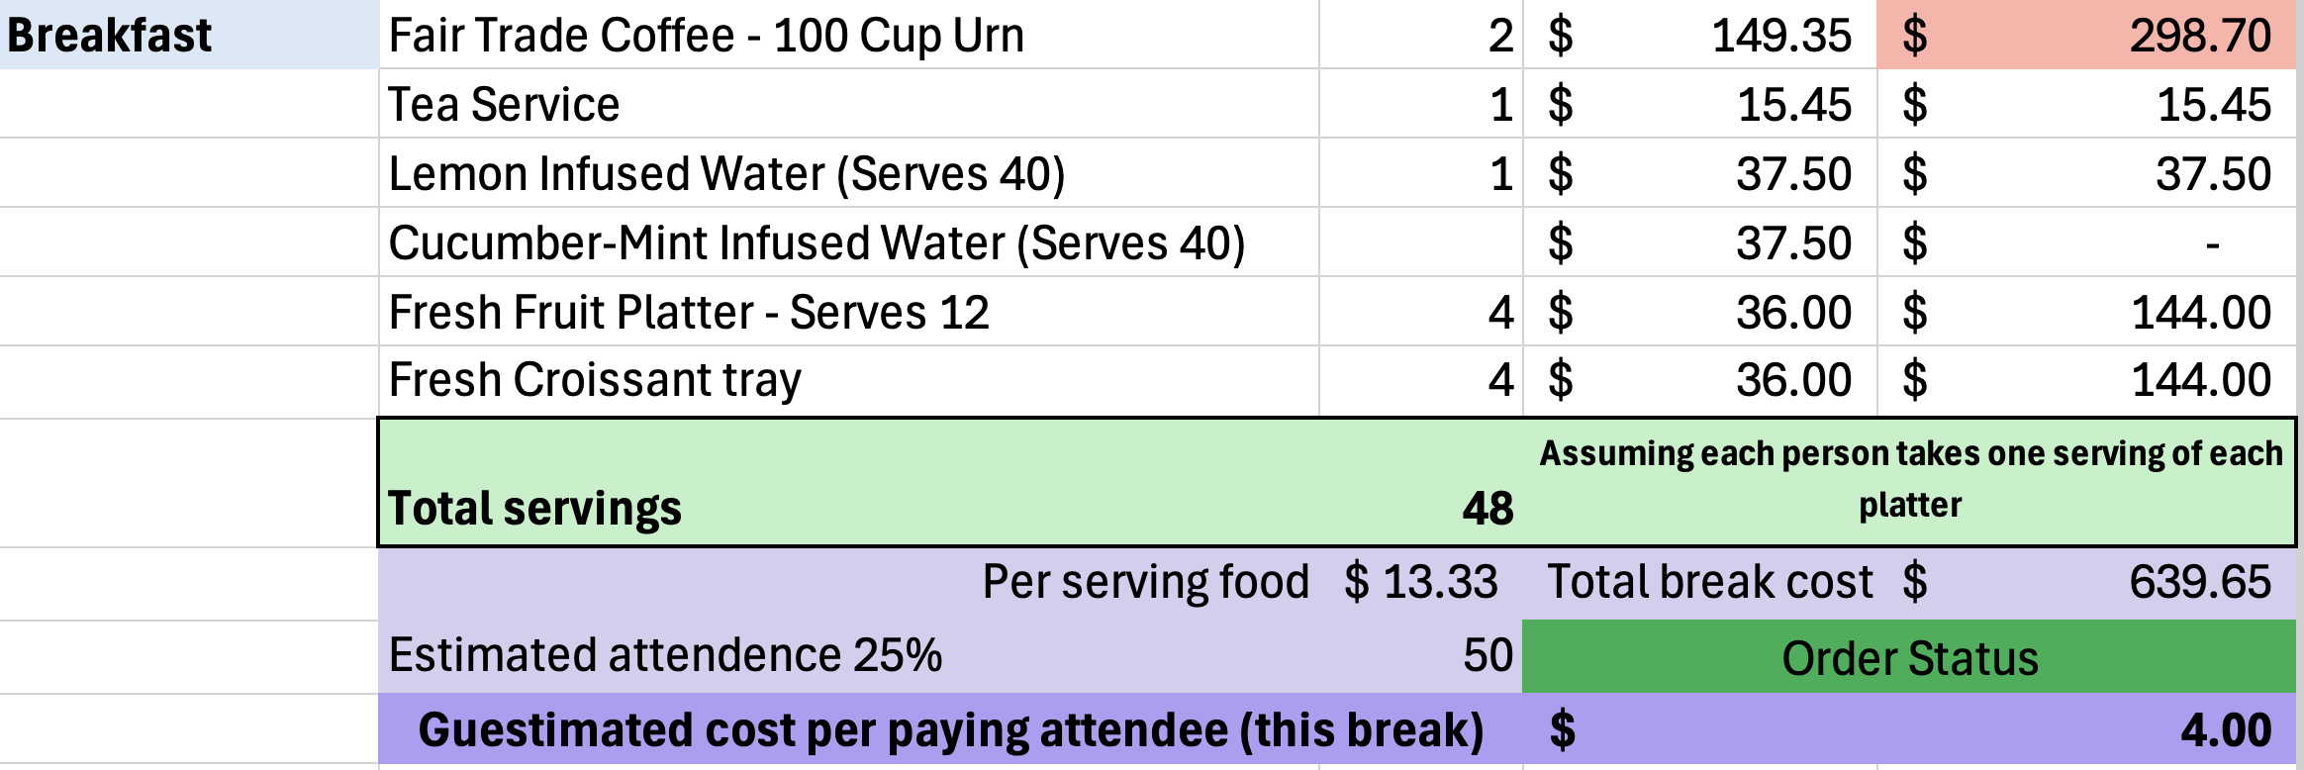
Thursday Breakfast
Most expensive item is red
Removed Cucumber mint water, most people don’t end up drinking the flavoured water and we have the refill stations
Total servings are based on the most limiting food item (Excluding cheese)
*
Estimated 200 total guests but only 160 paying guests, estimated $160 per paying guest
*
Order Status turns green when total servings is within 10% of the estimated attendance

Slide 3
Thursday Breakfast

Slide 4
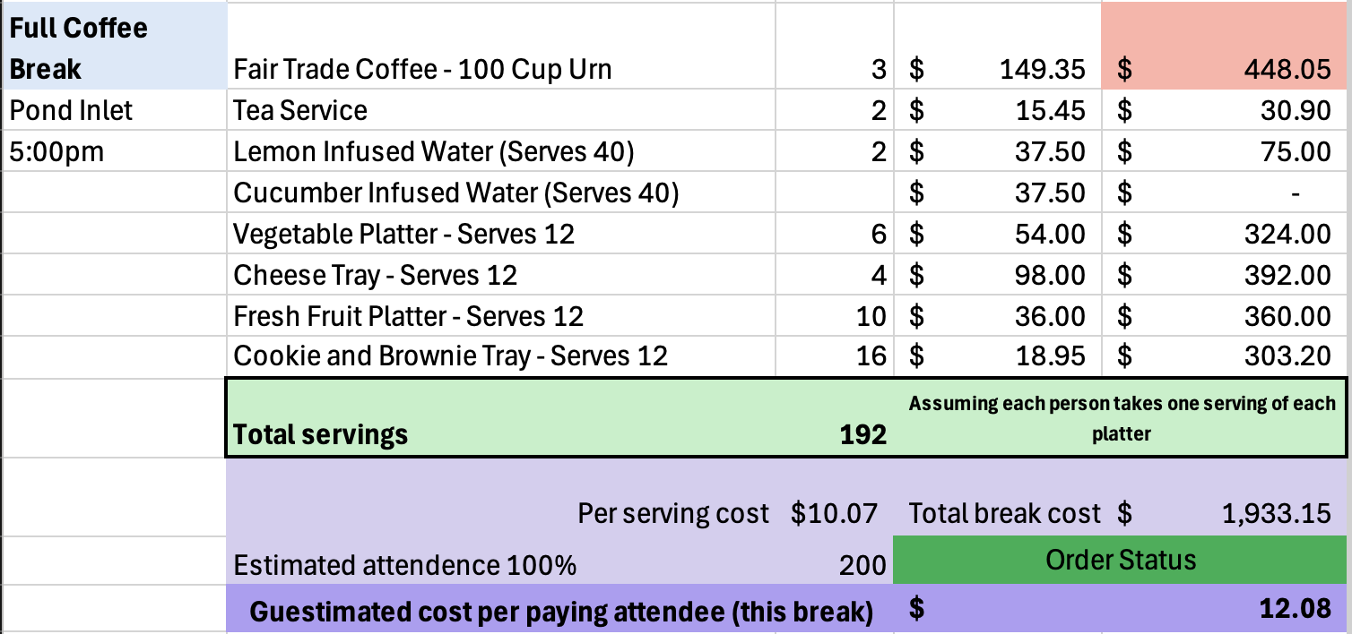
Thursday Keynote Reception

Slide 5
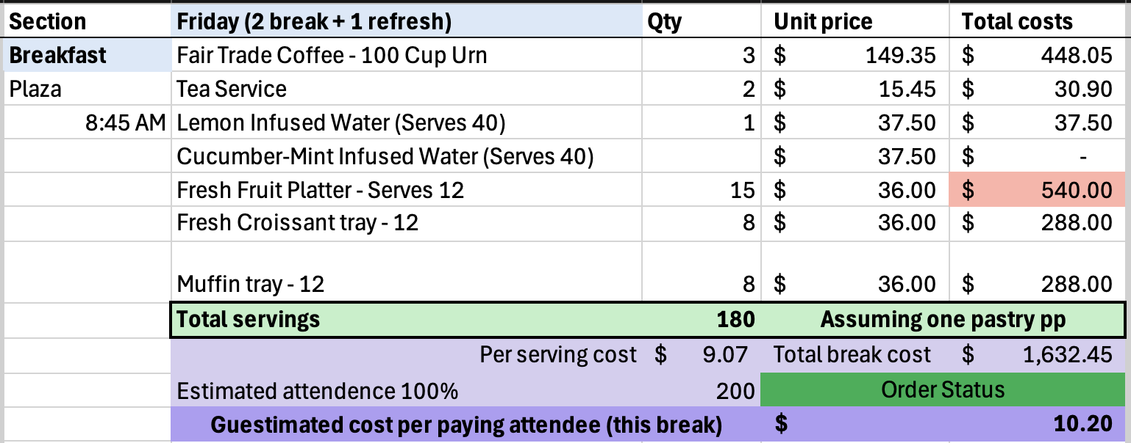
Friday Breakfast

Slide 6
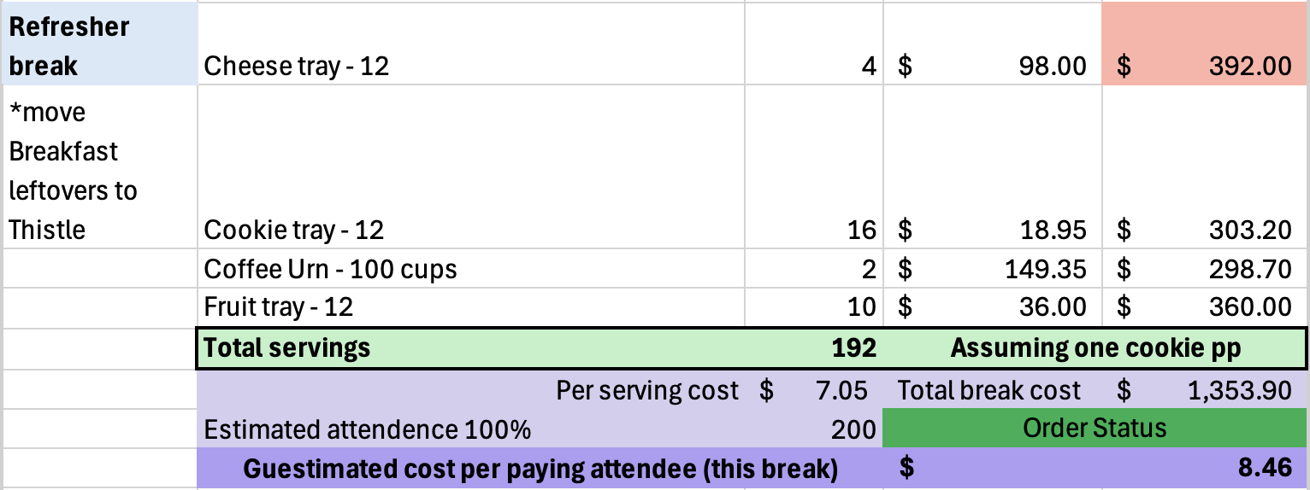
Friday Break
When there is something else with fruit, we assume fruit will serve 18 people and not 12. Cheese is too expensive to give full servings to each person, so we assume cheese feeds 24.

Slide 7
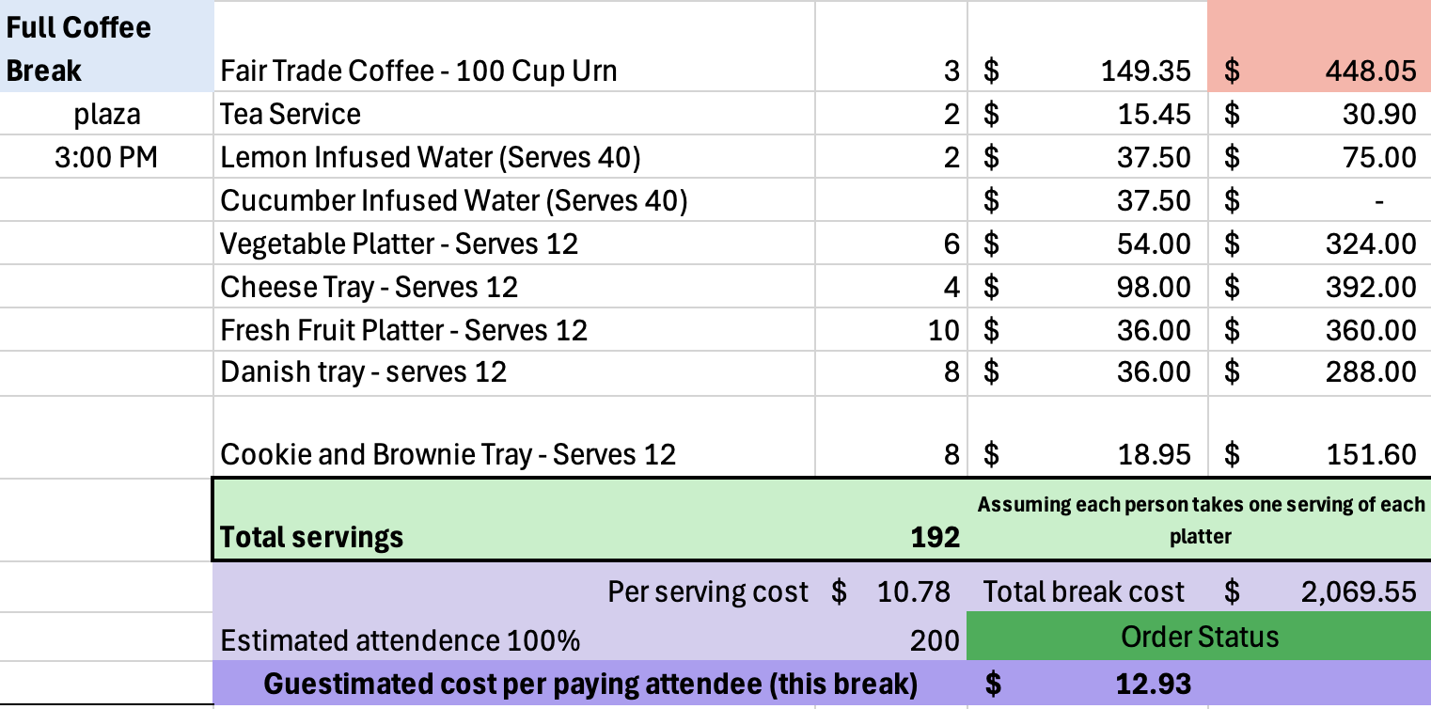
Friday Posters
Here I combined the Danishes and cookies so its like a one or the other. Refreshment monitors will have the awkward job of telling people not to take too much food, there will also be signs

Slide 8
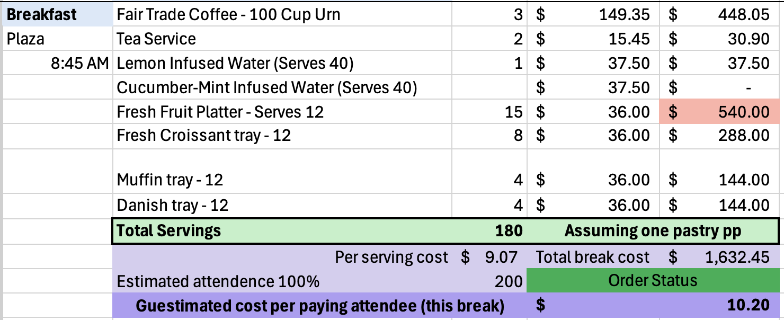
Saturday Breakfast

Slide 9
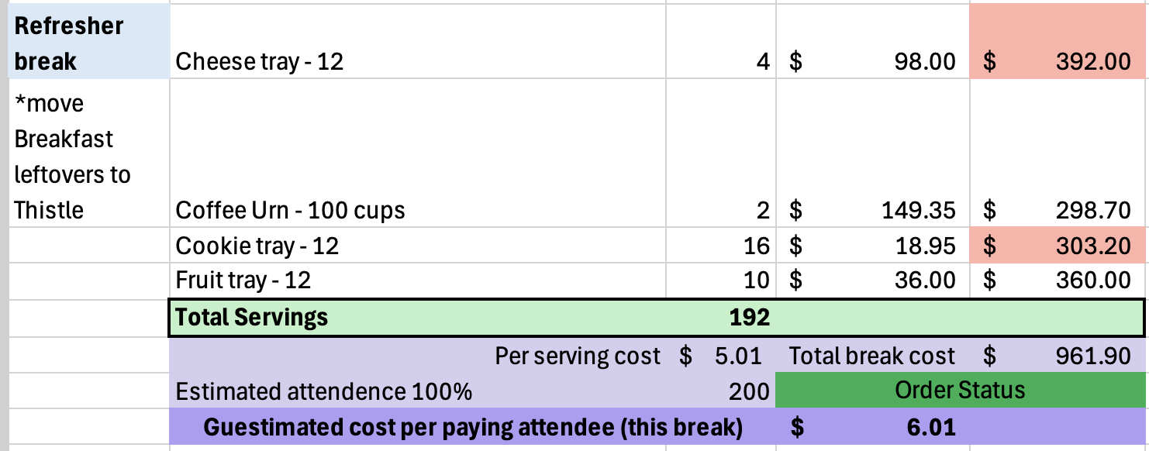
Saturday Break
Please note this is between concurrent sessions and any extras will be brought to the poster session. Poster session will not have a coffee break as it immediately follows lunch and precedes the closing ceremonies and final keynote which has refreshments

Slide 10
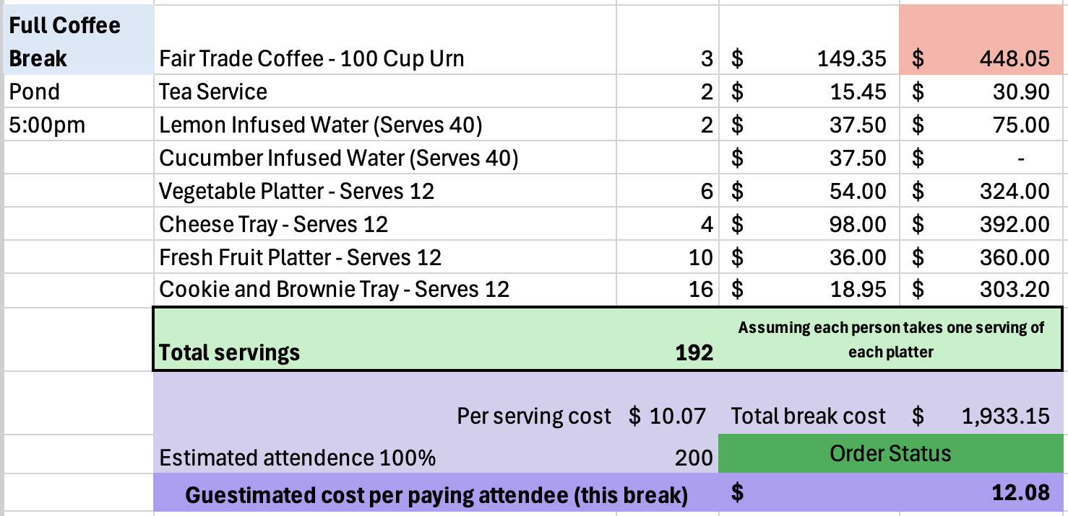
Saturday Closing Ceremonies

Slide 11
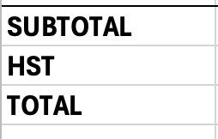
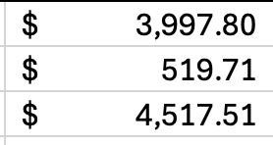
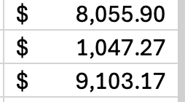
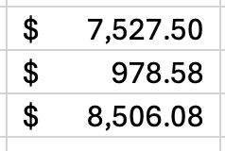
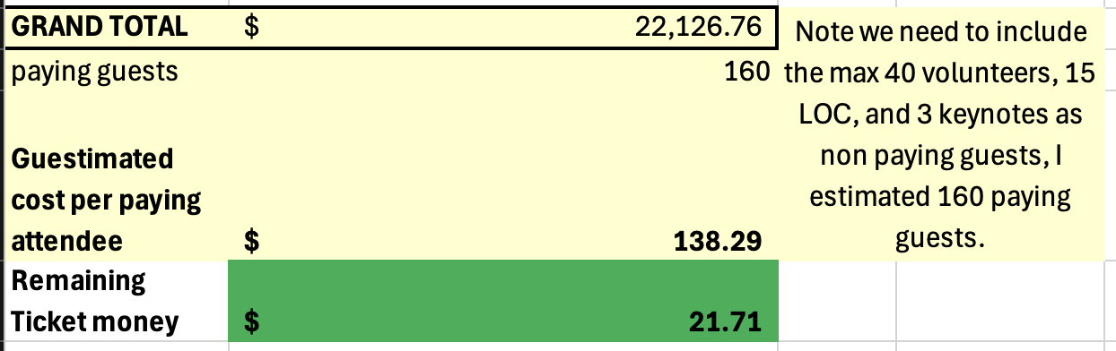
Totals
Thursday
Friday
Saturday
This includes a daily estimate of $3000 for lunch
There is $21.71 leftover per paying guest (just over $3470)

Slide 12
Lunch options
Build your own boxes
I’ve outlined a few different lunch options here. If we keep lunch at $20 per serving, we are in the clear.

Slide 13
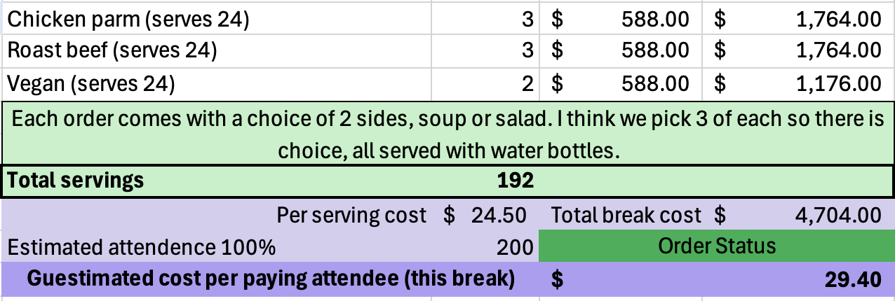
Individual Hot Lunches
We would love to be able to offer a hot lunch
They would be about $25 per person ($5000 per lunch)
Hot lunches put us over budget no matter how many or which days we do them.
Hot lunches all 3 days would be an extra $1000 on top of all 160 registration fees
Note both are sandwiches
No vegan option but they’ll make one
One hot lunch break estimated costs. (If this was Thursday it would be cheaper)

Slide 14
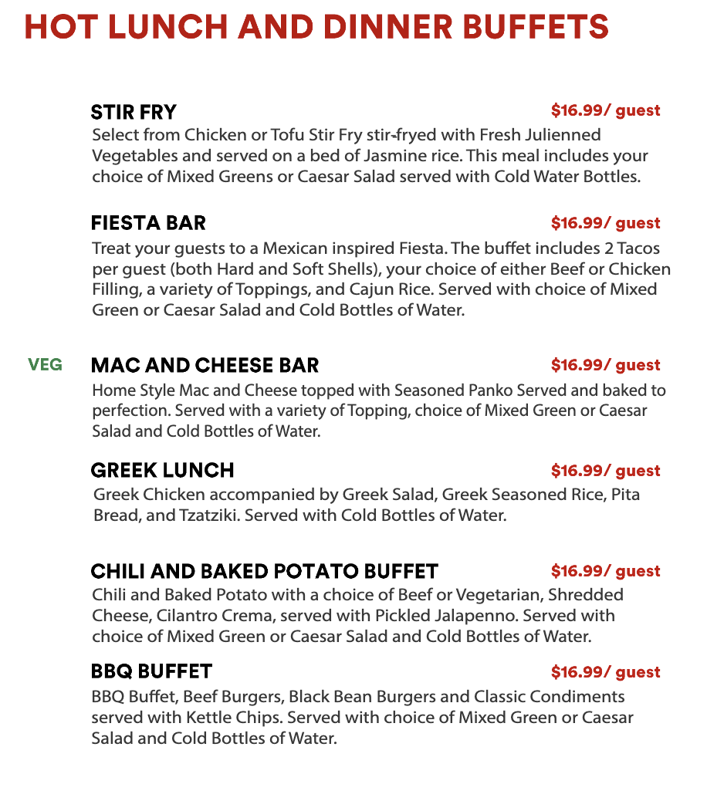
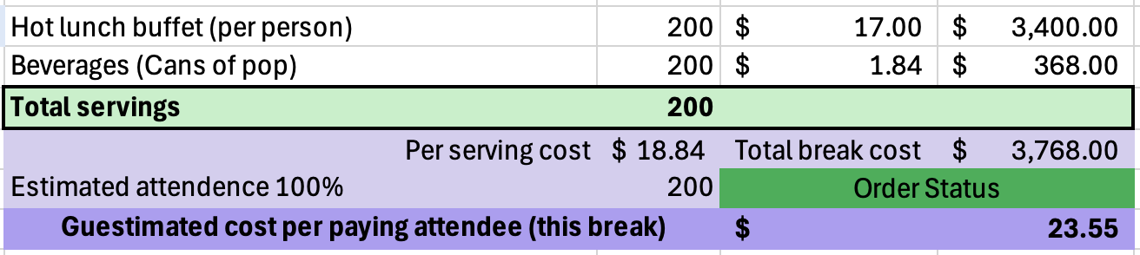
Hot Lunch Buffets
This is a secondary option for lunches
They’re expensive and there’s only one side option
Water is included but offering other beverages would be a good idea
Coffee would be about $200 cheaper; I think bottles or cans would be better
Cans of pop are the only open under $3 ea.
No vegan option but they’ll make one

Slide 15
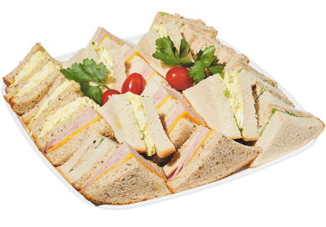
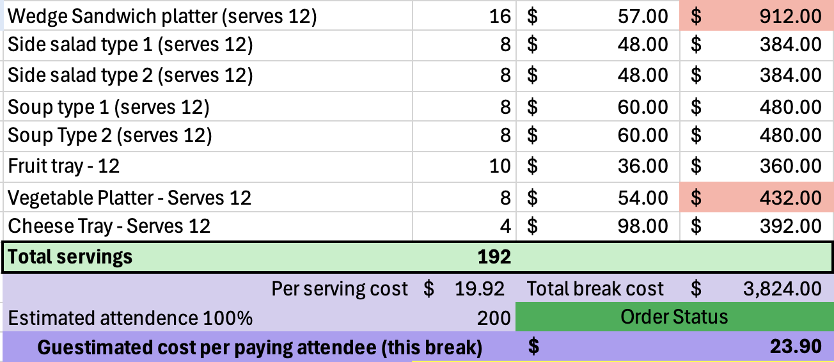
Cheap lunches
Sandwiches look like this
This is the cheapest lunch possible, it maximizes the quantity of food available for the price
They’re more like finger sandwiches
I added extras to make the lunch seem like more while staying in the $20 budget.

Slide 16
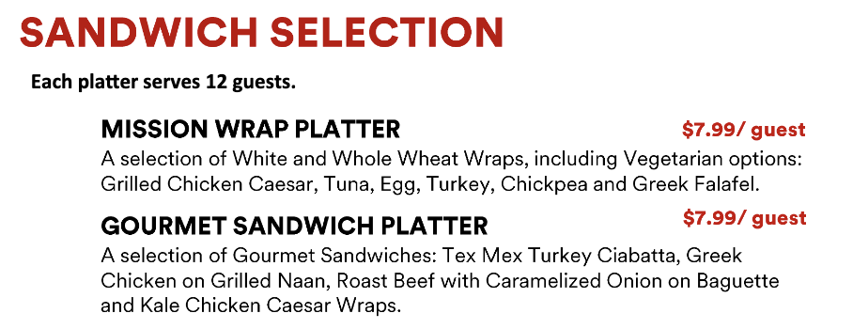
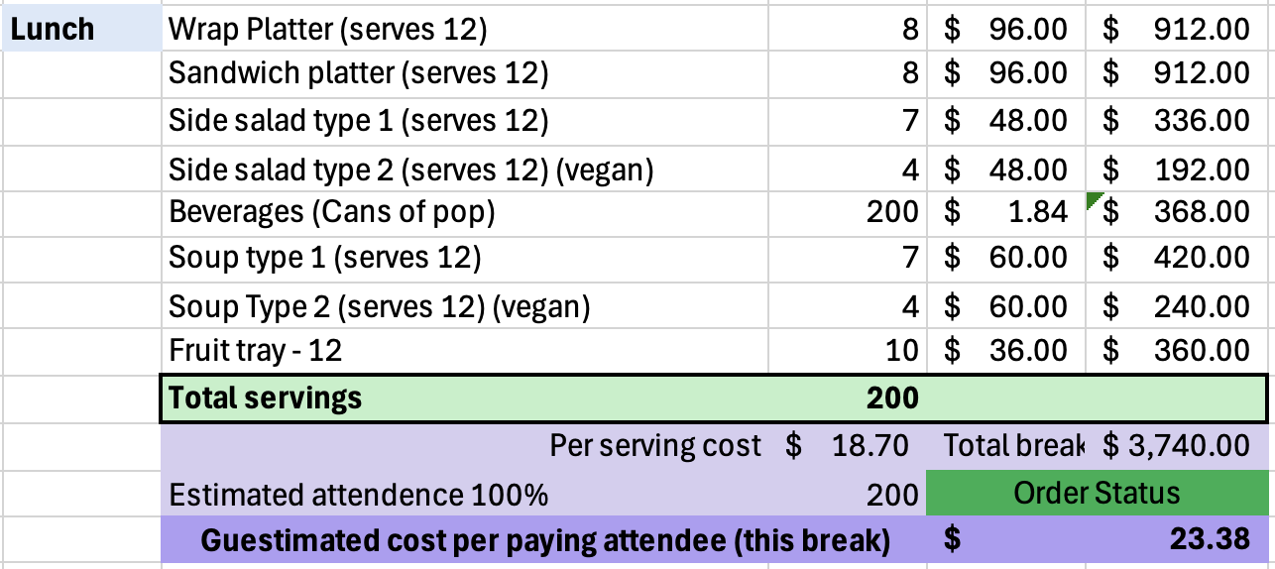
Best lunch option (in my opinion)
Fancier sandwiches
Need less extras
Still need beverages
We can mix and match the kinds I think

